Slide 1
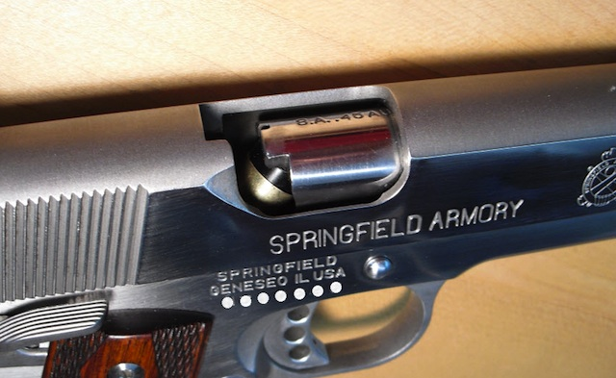
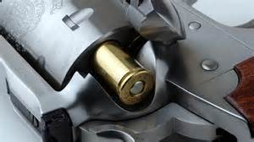
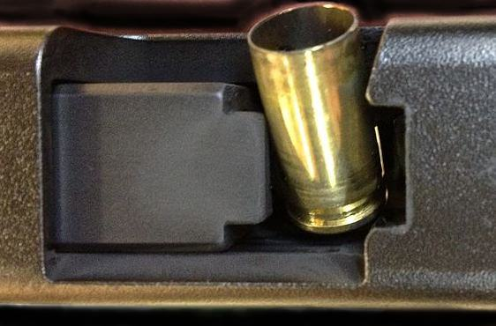
TREATING MALFUNCTIONS OF HANDGUNS
By: Velarde, Peter D.

Slide 2
TREATING MALFUNCTIONS OF HANDGUNS

Slide 3
TREATING MALFUNCTIONS OF HANDGUNS
The Type 1 malfunction is commonly referred to as a failure to feed or a failure to fire. A key symptom is the dreaded click you hear after pressing the trigger. On the range, your immediate response would probably be to stop and wonder what went wrong.

Slide 4
TREATING MALFUNCTIONS OF HANDGUNS
Common causes for a Type 1 malfunction are a failure to fully seat a magazine, which prevents a round from being stripped into the chamber; a bad round; or the operator’s failure to load the chamber. There are numerous other reasons why you would get a Type 1 malfunction, but these are by far the most common for a properly operating handgun.

Slide 5
TREATING MALFUNCTIONS OF HANDGUNS
To correct the Type 1, do the following drill: (1) Bring your shooting arm’s elbow back to your ribcage; (2) while keeping the muzzle target-oriented, rotate the ejection port clockwise toward the ground; (3) using the palm of your off-hand, with your fingers pointing up, sharply smack the base of the magazine to ensure it is fully seated; (4) using an overhand grip, rip-rack the slide like you are trying to rip it off of the frame; and (5) reestablish your grip and drive your sights back on target. This drill is often simply referred to as a tap-rack.

Slide 6
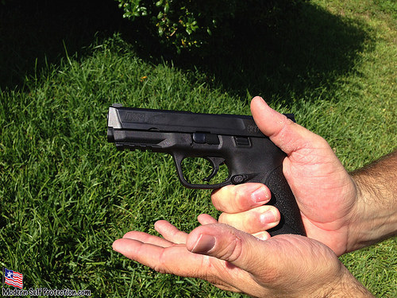
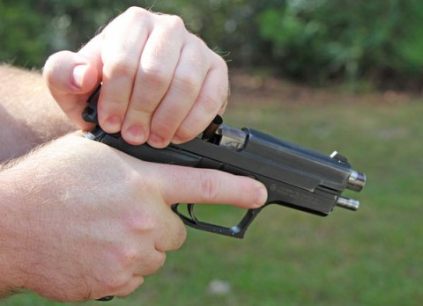
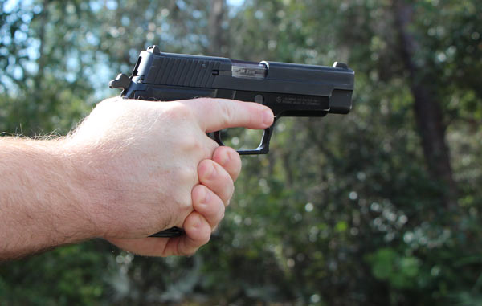
TREATING MALFUNCTIONS OF HANDGUNS

Slide 7
TREATING MALFUNCTIONS OF HANDGUNS
The Type 2 malfunction is often referred to as a stovepipe or a failure to eject. The key symptom of this malfunction is a dead trigger, meaning when you press the trigger, nothing happens. No click. No bang. Just mush. This malfunction gained the nickname “stovepipe” because, when a fired case fails to properly eject and becomes trapped in the pistol’s ejection port, it looks like a stove’s exhaust pipe.

Slide 8
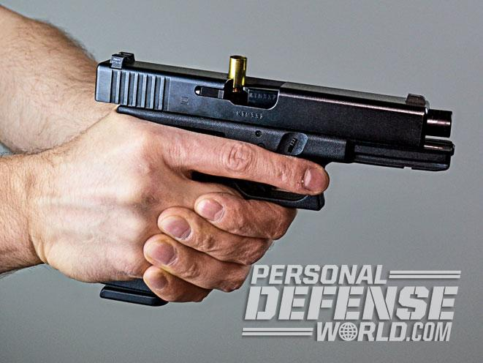
TREATING MALFUNCTIONS OF HANDGUNS

Slide 9
TREATING MALFUNCTIONS OF HANDGUNS
Common causes for a Type 2 malfunction are limp-wristing, or not providing solid enough resistance for the handgun during recoil; impeding the slide during recoil; underpowered ammunition; a broken or malfunctioning extractor or ejector; a malfunctioning magazine; or an overpowered recoil spring. By far the first two examples are the most common causes for a Type 2 malfunction, and they are basically due to operator error. This is a good thing because operator errors are easier to prevent and fix than mechanical failures.

Slide 10
TREATING MALFUNCTIONS OF HANDGUNS
The response to a Type 2 is identical to that of a Type 1: an aggressive tap-rack. The reason this works is that the next round to feed from the magazine helps push the stovepiped empty case out of the feed port. And with the feed/ejection port rotated toward the ground, gravity helps the case on its way.

Slide 11
TREATING MALFUNCTIONS OF HANDGUNS
The Type 3 malfunction (commonly called a double feed) is the mother of all malfunctions, short of a stuck case or a catastrophic part failure that renders the handgun inoperable. In the latter two malfunctions, you need to start thinking Plan B. There is no drill to fix them without tools.

Slide 12
TREATING MALFUNCTIONS OF HANDGUNS
The key symptom of a Type 3 malfunction is identical to that of a Type 2: a dead trigger. In a handgun, a Type 3 is the result of a live round heading into the chamber when another live round is already there.
Common causes of this malfunction essentially involve either an extractor failure, a magazine failure or a stuck case.

Slide 13
TREATING MALFUNCTIONS OF HANDGUNS
The drill for correcting a Type 3 malfunction is as follows: Without stopping to think or assess, (1) bring your shooting arm’s elbow back to your ribcage; (2) engage the slide stop with your shooting hand’s thumb and, using an overhand grip with your off-hand, rip-rack the slide like you are trying to rip it off of the frame; (3) using your off-hand, rip the magazine from the mag well and throw it to the ground; (4) while keeping the muzzle target-oriented, rotate the ejection port clockwise toward the ground; (5) using an overhand grip, rip-rack the slide three times like you are trying to rip it off of the frame; (6) perform an emergency reload; and (7) reestablish your grip and drive your sights back on target. Rip. Roll. Rack. Reload.

