Slide 1
HOMELAND SECURITY
By: Velarde, Peter

Slide 2
Homeland Security
Is an American umbrella term for "the concerted national effort to ensure a homeland that is safe, secure, and resilient against terrorism and other hazards where American interests, aspirations, and ways of life can thrive to the national effort to prevent terrorist attacks within the United States, reduce the vulnerability of the U.S. to terrorism, and minimize the damage from attacks that do occur."

Slide 3
Homeland security is not constrained to terrorist incidents. Terrorism is one of many threats that endanger society. Within the U.S., an all-hazards approach exists regarding homeland security endeavors. In this sense, homeland security encompasses both natural disasters and man-made events. Thus, the domain of homeland security must accommodate a plethora of situations and scenarios, ranging from natural disasters (e.g., Hurricane Katrina) to acts of terrorism (e.g., Boston Marathon bombing).

Slide 4
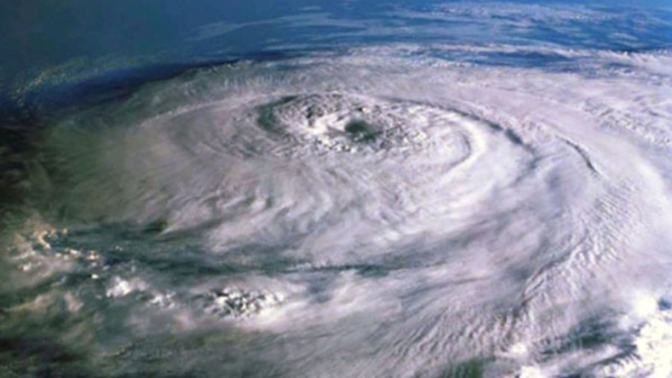
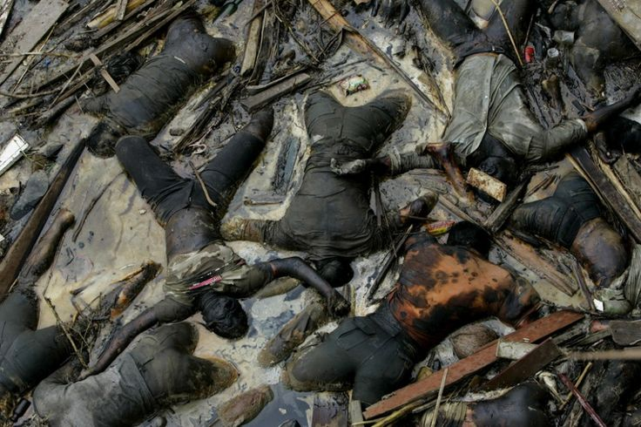
HURRICANE KATRINA
Hurricane Katrina was the eleventh named storm and fifth hurricane of the 2005 Atlantic hurricane season. It was the costliest natural disaster, as well as one of the five deadliest hurricanes, in the history of the United States.. Overall, at least 1,245 people died in the hurricane and subsequent floods, making it the deadliest United States hurricane since the 1928 Okeechobee hurricane. Total property damage was estimated at $108 billion (2005 USD), roughly four times the damage wrought by Hurricane Andrew in 1992.

Slide 5
BOSTON MARATHON BOMBING
On April 15, 2013, two bombs went off near the finish line of the Boston
Marathon, killing three spectators and wounding more than 260 other people.
Four days later, after an intense manhunt that shut down the
Boston area, police captured one of the bombing suspects, 19-year-old Dzhokhar Tsarnaev, whose older brother and fellow suspect, 26-year-old Tamerlan Tsarnaev, died following
a shootout with law enforcement
earlier that same day.

Slide 6
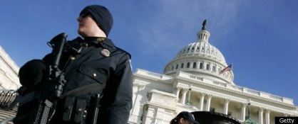
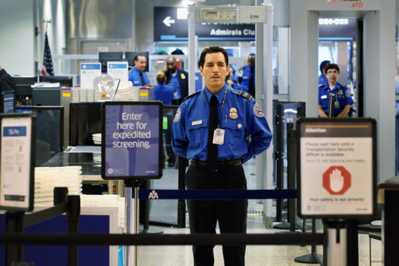
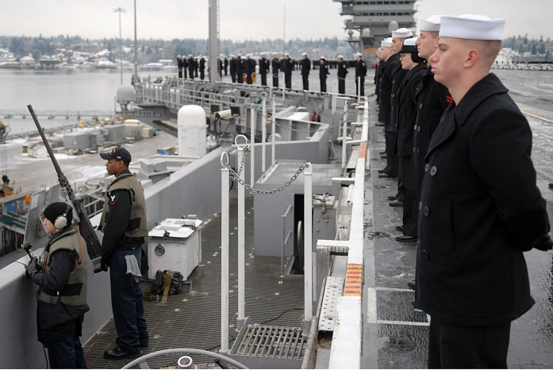
Homeland defense (HD) is the protection of U.S. territory, sovereignty, domestic population, and critical infrastructure against external threats and aggression.

Slide 7
In the United States, the concept of "Homeland Security" extends and recombines responsibilities of government agencies and entities. According to Homeland security research, the U.S. federal Homeland Security and Homeland Defense includes 187 federal agencies and departments, including the United States National Guard, the Federal Emergency Management Agency, the United States Coast Guard, U.S. Customs and Border Protection, U.S. Immigration and Customs Enforcement, United States Citizenship and Immigration Services, the United States Secret Service, the Transportation Security Administration, the 14 agencies that constitute the U.S. intelligence community and Civil Air Patrol.

Slide 8
The George W. Bush administration consolidated many of these activities under the United States Department of Homeland Security (DHS), a new cabinet department established as a result of the Homeland Security Act of 2002. However, much of the nation's homeland security activity remains outside of DHS; for example, the FBI and CIA are not part of the Department, and other executive departments such as the Department of Defense and Department of Health and Human Services

Slide 9
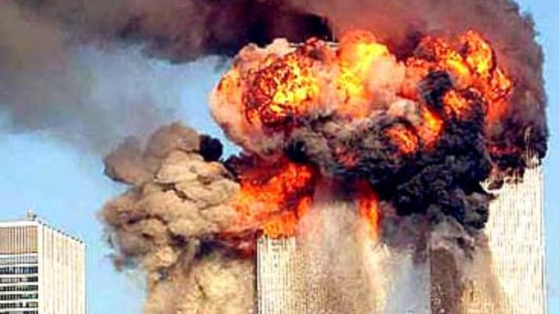
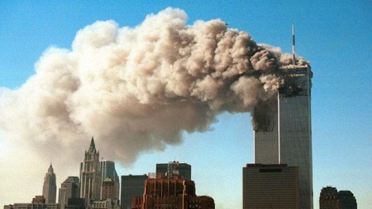
The term became prominent in the United States following the September 11, 2001 attacks; it had been used only in limited policy circles prior to these attacks. The phrase "security of the American homeland" appears in the 1998.

Slide 10
The scope of homeland security includes:
Emergency preparedness and response (for both terrorism and natural disasters), including volunteer medical, police, emergency management, and fire personnel;
Domestic and International intelligence activities, largely today within the FBI;
Critical infrastructure and perimeter protection;
Investigation of people making and distributing child pornography;
Border security, including both land, maritime and country borders;
Transportation security, including aviation and maritime transportation;
Biodefense;
Detection of radioactive and radiological materials;
Research on next-generation security technologies

Slide 11
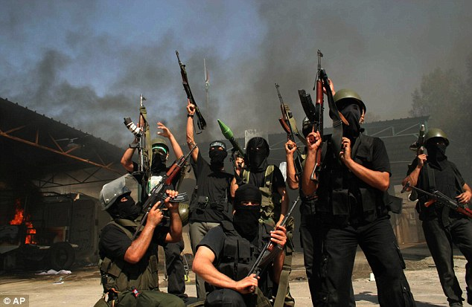
The National Security Strategy
Defeat Terrorism Worldwide
Administration also intends to provide $5 billion in assistance through the Shared Security Partnership over the next several years to enhance the ability of their partners to improve their own security and work with the US to defeat terrorism worldwide.

Slide 12
The National Security Strategy
Strengthen Our Bio and Nuclear Security
Attacks using improvised nuclear devices or biological weapons, as well as outbreaks of a pandemic disease, pose a serious and increasing national security risk, We will focus on reducing the risk of these high-consequence, nontraditional threats:
Ensuring that decision-makers have the tools they need to manage disease outbreaks by linking health care providers, hospitals, and public health agencies.
Strengthening our nuclear security by enhancing our nuclear detection architecture and ensuring that our own nuclear materials are secure.

Slide 13
The National Security Strategy
Improve Intelligence Capacity and Information Sharing
Gathering, analyzing, and effectively sharing intelligence is vital to the security of the United States. In order to prevent threats, including those from terrorism, we will strengthen intelligence collection to identify and interdict those who intend to do us harm. The information we collect must be analyzed as well as shared, and we must invest in our analytic capabilities and our capacity to share intelligence across all levels of government.

Slide 14
The National Security Strategy
Ensuring a Secure Global Digital Information and Communications Infrastructure
The United States is an increasingly digital nation where the strength and vitality of our economy, infrastructure, public safety, and national security have been built on the foundation of cyberspace. Despite all of our efforts, our global digital infrastructure, based largely upon the Internet, is not secure or resilient enough today and future purposes. Effectively protecting cyberspace requires strong vision and leadership and will require changes in policy, technology, education, and perhaps law.

Slide 15
The National Security Strategy
Promote the Resiliency of our Physical and Social Infrastructure
Ensuring the resilience of our critical infrastructure is vital to homeland security. Working with the private sector and government partners at all levels will develop an effective, holistic, critical infrastructure protection and resiliency plan that centers on investments in business, technology, civil society, government, and education.

Slide 16
The National Security Strategy
Pursue Comprehensive Transborder Security
To address transnational threats effectively, we must take a comprehensive approach to securing our borders, including working with international partners, state and local governments, and the private sector. The President supports efforts to develop and deploy technology to maximize port security without causing economic disruption, and enhancing the security of key transportation networks—including surface, air, and maritime networks—that connect our nation and the world.

Slide 17
The National Security Strategy
Ensure Effective Incident Management
The Obama Administration has already effectively managed several domestic events, including severe winter ice storms throughout the Midwest and record flooding in North Dakota and Minnesota. Our goal is to improve coordination and to actively listen to the concerns and priorities at all levels of government. In doing so, we can create better evacuation planning guidelines, increase medical surge capacity, and increase Federal resources and logistics to better support local emergency planning efforts.

Slide 18
THE END…
Thank you for listening…

