Slide 1
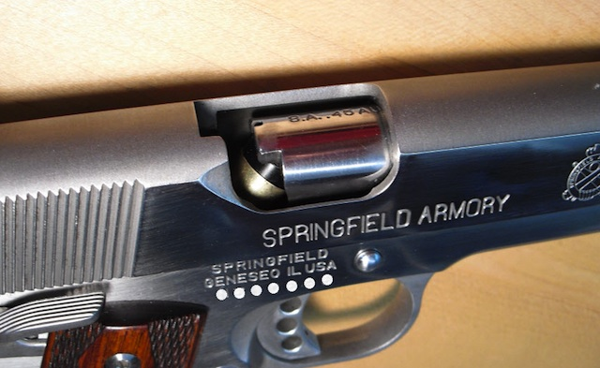
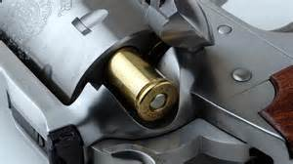
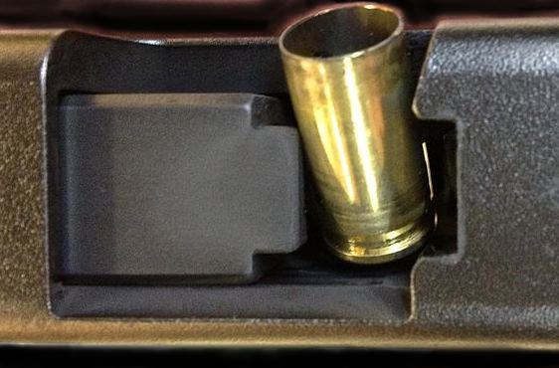
TREATING MALFUNCTIONS OF HANDGUNS
By: Velarde, Peter D.

Slide 2
TREATING MALFUNCTIONS OF HANDGUNS
TYPES
1. Hang Fire
If you pull the trigger and it doesn’t go “Boom”, you may have a Hang Fire situation going on. A hang fire is a delay in the propellant being ignited. If this malfunction is suspected, the procedure is to keep the firearm pointed down range for at least 30-60 seconds. This will ensure that the propellant won’t be ignited. After that time has passed, you should clear the firearm of the dud and drop it in some water as a precaution.

